Slide 1
AGENDA
Day 1
What is Unix? History of Unix and Linux – Why Linux?
Kernel, Shell, Files and Directories, Directory Structure, Filesystems and structure of filesystems, Shells
Redhat Distributions – Redhat Linux to Redhat Enterprise Linux
Commands
Brief difference and similarities between RHEL 7 and RHEL 6/5
Booting Process
Installation, configuration and management of RHEL 7
Day 3
Introduction to XFS and management
Introduction to BtrFS
What is Systemd and how it helps RHEL 7
What is swap and how can we manage swap?
Practicals on XFS, Systemd and Swap Management
Day 2
Booting procedure of RHEL 7 Continued
Package management in RHEL 7, understanding RPM and YUM
Setting up repository and installing packages/updates through Yum
Logical Volume Management – Why LVM? LVM Administration
Networking in RHEL 7 (Basic and Advanced configuration)
Practicals on Yum, LVM and Networking
Day 4
Installation and configuration of iSCSI Target/Initiator
Understanding Multipathing and its configuration in RHEL 7
Basics of Clustering
Apache service Installation and Configuration
Practicals on iSCSI, Multipathing and Apache Installation/Configuration
Root password recovery in RHEL 7 and Helpful utilities for System Administrators in day-to-day life
Questions & Answers

Slide 2
DAY 1

Slide 3
A little history, before Linux
UNIX is a multi-tasking and multi-user Operating System
Developed in 1969 at AT&T’s Bell Labs by
Ken Thompson (UNIX)
Dennis Ritchie (C)
Douglas Mcllroy (Pipes - Do one thing, do it well)
Some other popular variants of UNIX: System V, Solaris, SCO Unix, SunOS, 4.4BSD, FreeBSD, NetBSD, OpenBSD, BSDI
These commercial variants were very costly and are not targeted towards Micro Computers
When Microsoft released Disk Operating System (DOS) to could run on a Personal Computer, in 80’s, DOS became the dominant OS for PC
Apple’s MAC was better, but expensive
UNIX was much better, but much, much more expensive. It was mainly designed to run on minicomputers for commercial applications
People were looking for a UNIX based system, which is cheaper and can run on PC (Micro computer)
DOS, MAC and UNIX were proprietary, i.e., the source code of their kernel is protected
No modification is possible without paying high license fees

Slide 4
What is Linux?
Richard Stallman, who believed that software should be free from restrictions against copying or modification in order to make better and efficient computer programs has started a project called GNU (GNU’s Not Unix). It aimed at developing a complete Unix-like OS which is free for copying and modification. Stallman built his first free GNU C Compiler (GCC) in 1991. However, a complete OS was yet to be developed at that time.
A Finnish graduate student, Linus Torvalds created a Monolithic Kernel out of hobby in 1991
It was inspired by a simplified version of UNIX developed by his professor, Andrew Tanenbaum for teaching purpose called MINIX (Micro-Unix which used Micro Kernel)
Linus' MINIX became Linux
Linux Consists of
Linux Kernel
GNU (GNU is Not Unix) Software
Software Package management
Other tools and utilities

Slide 5
Structure of Linux
Users
Hardware
Hardware is the center point of any Linux system. But, it can only understand Low Level Language instructions which a normal human being of present age cannot provide. Thus a first level interpreter is necessary
Kernel
Kernel acts like a first level interpreter which can couple hardware with another layer which can provide High Level Language instruction. Still, this directly is not user friendly
Shell
Shell is the actual command interpreter which takes in human readable commands as input and translates them into something a Kernel can understand
Users
All users login to the systems launching their own preferred shells and then interact with the system the way they like
Shell
Kernel
HW

Slide 6
Different types of Shells
Commonly used Shells
sh -> Bourne Shell (One of the oldest of shells)
csh -> C Shell (Uses syntax used in C Language)
ksh -> Korn Shell (Inherits the advantages of Bourne Shell and C Shell)
bash -> Bourne Again SHell (Inherits the advantages of all three predecisors)
BASH is the default shell in Linux and users are free to chose their own favourite. Other not-so-famous shells available for use – tcsh, zsh
Shell built-ins are those commands which can be used when a shell gets loaded. These are also referred as Intrinsic/Internal commands. Other commands are available as external files/binaries. Such commands are normally referred as extrinsic/external commands

Slide 7
The Linux File System Hierarchy

Slide 8
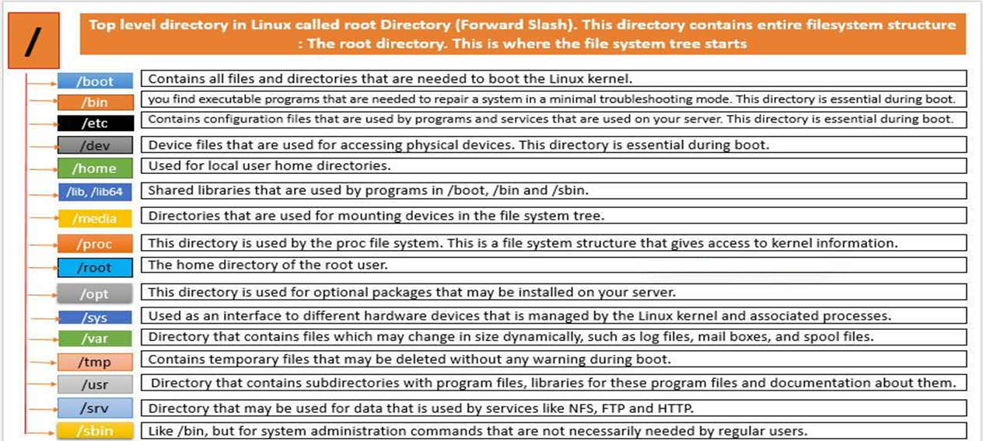
Linux Directory Structure

Slide 9
Linux File System Hierarchy Standards:
Hierarchical File System [Filesystem Hierarchy Standard (FHS ] - Linux provides a standard file structure in which system files/ user files are arranged under / “root” only.

Slide 10
Absolute and Relative path references

Slide 11
Commands
Each and everything happening in Linux happens through FILES. It is necessary to understand types of files that can be commonly seen in Linux. Following are the commonly found types of files in a Linux system
Normal/Binary files, Device Files, Executable Files, Text/ASCII files, IPC - Inter-Process Communication files, Socket Files, Door Files, FIFO Files, Link files, Directory (Directory is also a file), Null File (Equivalent to a black hole)
Based on this, different types of commands can be classified into below broad categories
Commands that provide information on files – ls, file
Commands that manipulate files – touch, rm, chmod, chown, chgrp, mv, cp, cat, ln etc
Commands that manipulate directories – mkdir, rmdir
User related commands – useradd, userdel, usermod, groupadd, groupdel, groupmod etc
Locating commands – find, which, locate (use updatdb first to populate locate db)
Commands used to determine command usages – man, info, pinfo and individual command help
Administrative commands – All commands that are intended to modify system wide configuration (hostnamectl, systemctl etc)
Status commands
File content display/search commands – cat, strings, grep
Storage related commands – fdisk, vgs, lvs, pvs, vgcreate, lvcreate, pvcreate etc
File comparison commands – diff, sdiff
Scheduling commands – crontab, at, batch
Commands used to communicate between systems – ssh, telnet, rlogin etc
Printing commands – lp, lpstat, lpq etc

Slide 12
BASH Features: Default Shell in Linux
$ sign = local user/non-privilege user
# sign = Administrator/Privileged user
[desingh@linuxtest7 ~]$ → Local User Account
[root@linuxtest7 ~]# → Root/Super User Account [root@linuxtest7 ~]# cat /etc/shells
/bin/sh
/bin/bash
/sbin/nologin
/bin/dash
/bin/tcsh
/bin/csh
/bin/ksh

Slide 13
BASH Features Continued:
Command Line Completion:
Single Tab – it will provide the best option
Double Tab – it will provide all the possible options (Autocompletes)
Command Line Editing:
Ctrl+a - It moves cursor to the Home line position
Ctrl+b - Moves the cursor back one character
Ctrl+c - Sends the signal SIGINT to the current task, which aborts and close it.
Ctrl+d - Close current shell prompt
Ctrl +r - recall the commands

Slide 14
BASH Features: Continued:
Command Line History: Command line history is saved on execution of any command in terminal.
$ history - this command will display all the previous executed commands
$ history –c - Clear the command history
$ !<number> - it executes mentioned number command
Note: Default history size is 1000 commands
$ !<charactar> - it will display/execute matching character command
$ !! - it will execute last executed command

Slide 15
BASH Features Continued:
Piping and Redirecting:
Redirecting input and output from standard stream to user defined place
Send stdout to file ;command > file
Send stderr to file; command 2> file
Send stdout and stderr to file ; command > file 2>&1 >
[root@linuxtest7 desingh]# ls new.txt ddd 2> output.log
new.txt
[root@linuxtest7 desingh]# cat output.log
[root@linuxtest7 desingh]# ls new.txt ddd > output.log 2>&1
[root@linuxtest7 desingh]# cat output.log
ls: cannot access ddd: No such file or directory
new.txt
ls: cannot access ddd: No such file or directory

Slide 16
BASH Features Continued:
Piping sending output or one command as a input to the another command | pipe
Page related command:
Less: is used to see the command output page by page in up and down way
More: we can’t go upward downward, just see the output fit to the screen [root@linuxtest7 ~]# cat /var/log/messages|less
[root@linuxtest7 ~]# cat /var/log/messages|more

Slide 17
Basic Linux Commands
~]$ pwd #Print working directory
~]$ who am I #To see from which user you have logged in
~]$ who #To see all who is logged in yet this point of time from which IP
~]$ w #More details about user related info
~]$ uptime #To see the server up time, boot time, users and load
~]$ uname –a #Verify Operating system version, kernel version and architecture
~]$ touch <File Name> #Create an empty file

Slide 18
Basic Linux Commands
~]$ mkdir <Directory Name> #Create an empty directory / directories
~]$ mkdir –p <directory/directory/directory> #to create parent directories
~]$ cd <Path of the directory> #Change directory
~]$ cat <File Name> #View content of file
~]$ time #Calculate response time of the activity / command
~]$ hwclock #to see detailed date and time with time zone
~]$ cp <Source path> <Destination path>#Copy the files from one path to another path
~]$cp –Rv <source> <destination> #copy directories from source to destination

Slide 19
Basic Linux Commands
~]$ mv <source> <destination> #Move files/directories
~]$ mv <old name> <new name> #Rename the file and directory
~]$ last #Check who logged in and when logged in duration
~]$ arch #to know architecture
~]$ reboot / init 6 #Restart server
~]$poweroff / init 0 #To shut down the server
~]$ dmesg #Check boot process logs

Slide 20
Basic Linux Commands
~]$ nsloookup <Server Address> #check dns resolution
~]$ dig <server address> #check dns resolution to debug
~]$ tree <directory> #it will show the tree of parent directory
~]$ stat <file name> #detailed information about file
~]$ whatis <Command Name> #will display single line description about command
~]$ whereis <Command Name> #It will provide you path of the command
~]$ man <command> #manual page of the command
~]$ info <command> #information about the command
~]$ <command> --help #it will gives a command options and there usage
~]$ apropos <keyword> #to know about the command use

Slide 21
Basic Linux Commands & Boot Process Grub Recovery Rhel5/6

Slide 22
User Login Profile Management in Linux
A user profile is explicit digital representation of a User's identity user, or a customized desktop environment.
/etc/profile - Contains system void variables, effect administrator & local user profiles.
~/.bash_profile - it contains user specific variables only.
/etc/bashrc - it contains system void alias variables
~/.bashrc - it contains user specific alias variables
.bash_history - it contains all executed commands history

Slide 23
User Login Profile Management in Linux Continued:
Create Alias:
[desingh@linuxtest7 ~]$ alias cp='cp -i‘ – Create alias
[desingh@linuxtest7 ~]$ alias - it will show the aliases
[desingh@linuxtest7 ~]$ unalias cp – Remove alias
Define alias in Profile using alias using /etc/bashrc OR .bashrc files
alias aliasname='commands'

Slide 24
User Login Profile Management Continued:
File Permissions & UMASK Value:
Permissions to File/Dir is for User(owner), Group & Others
Default permissions for User, Group & Others (ugo) when you create a file or directory
File= 644 -> 6 for User (Owner of File), 4 For Group of Filer and last 4 is for Other than owner & Group of File
Directory=755 ->6 for User (Owner of Dir), 4 For Group of Dir and last 4 is for Other than owner & Group of Dir

Slide 25
User Login Profile Management Continued:
Permission | Value | Number
Read | r | 4
Write | w | 2
execute | x | 1

Slide 26
User Login profile Management Continued:
Commands to change File /Directory permissions: (chmod)
#chmod 744 file/directory
# chmod u+rwx file or directory : in case of user only
# chmod ug+rwx file or directory : in case of user and group
# chmod u+w,g+r,o+x directory/file
# chmod u+rw,g+rw directory/file
# chmod u-r, g-w,o-rw directory/file
# chmod ugo+rwx file/directory
# chmod ugo-rwx file/directory

Slide 27
User Login Profile Management Continued
Commands to change ownership for File/Directory (chown/chgrp)
# chown [options] <new owner> <file/directory> - to change ownership of file/folder
#chown user2 file1
#chown user1:group1 file2
# chgrp [options] <new group> <file/directory> - to change group of file/folder
chgrp gorup2 file2

Slide 28
Users Administrations:
Users Type:
Root/Super/Adminstartor User:Default user highly privileged UID is 0. This is created while installing the operating system
System Users: Nothing but services, at the time of installing particular package. UID starts from 1 to 499.
Local Users: Admin/Root User will create these users UID 500-65534
After creating a user, its home directory will be created in default path /home.
One group is will be created with same user name (primary group)
Files from /etc/skel will be copied automatically to user home directory
/etc/passwd & /etc/shadow file is updated with user information
/etc/group file is updated with primary group information

Slide 29
Users Administrations:
Imp files related to users:
/etc/passwd User Information
/etc/shadow User Passwords
/etc/group Group Information
/etc/gshadow contains secure group information.
User Administration Commands:
# useradd <user name> - To create specified local user
# useradd –d <home directory> <user name> - create a user with specified home path

Slide 30
Users Administrations:
Username: It is used when user logs in. It should be between 1 and 32 characters in length.
Password: An x character indicates that encrypted password is stored in /etc/shadow file.
User ID (UID): Each user must be assigned a user ID (UID). UID 0 (zero) is reserved for root and UIDs 1-99 are reserved for other predefined accounts. Further UID 100-999 are reserved by system for administrative and system accounts/groups.
Group ID (GID): The primary group ID (stored in /etc/group file)
User ID Info: The comment field. It allow you to add extra information about the users such as user’s full name, phone number etc. This field use by finger command.
Home directory: The absolute path to the directory the user will be in when they log in. If this directory does not exists then users directory becomes /
Command/shell: The absolute path of a command or shell (/bin/bash). Typically, this is a shell. Please note that it does not have to be a shell.

Slide 31
Users Administrations:
Username : It is your login name.
Password : It is your encrypted password. The password should be minimum 6-8 characters long including special characters/digits and more.
Last password change (lastchanged) : Days since Jan 1, 1970 that password was last changed
Minimum : The minimum number of days required between password changes i.e. the number of days left before the user is allowed to change his/her password
Maximum : The maximum number of days the password is valid (after that user is forced to change his/her password)
Warn : The number of days before password is to expire that user is warned that his/her password must be changed
Inactive : The number of days after password expires that account is disabled
Expire : days since Jan 1, 1970 that account is disabled i.e. an absolute date specifying when the login may no longer be used.

Slide 32
Users Administrations:
# useradd –u <UID> <user name> - create user with specific UID.
# passwd <user name> - change the user password
# userdel <user name> - delete user
# userdel -d <user name> - delete user including home directory
# chfn <user name> - Change user information
#finger – to display userinformation (need pkg for finger first)
Chage –l <username> - check expiry of user

Slide 33
Users Administrations:
Usermod command options:
-d = To modify the directory for any existing user account.
-g = Change the primary group for a User.
-G = To add a supplementary groups.
-a = To add anyone of the group to a secondary group.

Slide 34
Users Administrations:
Usermod command examples
[root@desingh@linuxtest7 ~]# groups newuser
newuser : newuser
[root@desingh@linuxtest7 ~]# usermod -a -G root,mytest newuser
[root@desingh@linuxtest7 ~]# groups newuser
newuser : newuser root mytest
[root@desingh@linuxtest7 ~]#
[root@desingh@linuxtest7 ~]# usermod -g ftptest newuser
[root@desingh@linuxtest7 ~]# id newuser
uid=503(newuser) gid=60000(ftptest) groups=60000(ftptest),0(root),502(mytest

Slide 35
Crontab & Tasks Automation:
[root@linuxtest7 ~]# at -m now +2 min
at> cp -p /var/tmp/new/* /var/tmp/new1/
at> <EOT>
job 14 at 2016-08-23 00:46
[ [root@linuxtest7 ~]# atq
14 2016-08-23 00:46 a root
[root@linuxtest7 ~]# atq
[root@linuxtest7 ~]# ls -lht /var/tmp/new1/
total 8.0K
-rw-r--r-- 1 root root 6 Aug 23 00:36 file1
-rw-r--r-- 1 root root 3 Aug 23 00:35 file
You have new mail in /var/spool/mail/root

Slide 36
Crontab & Tasks Automation:
CRONTAB: Crontab is a file which contains the schedule of cron entries to be run and at specified times The crontab is a list of commands that you want to run on a regular schedule, and also the name of the command used to manage that list.
Example: crontab –e - to edit the jobs
crontab –l - to list the scheduled jobs
crontab –c –u <user name> - to see particular user jobs
crontab –r - to remove crontab file

Slide 37
Crontab & Tasks Automation:
crontab format
# * * * * * command to execute
# │ │ │ │ │
# │ │ │ │ │
# │ │ │ │ └───── day of week (0 - 6) (0 to 6 are Sunday to Saturday, or use names; 7 is Sunday, the same as 0)
# │ │ │ └────────── month (1 - 12)
# │ │ └─────────────── day of month (1 - 31)
# │ └──────────────────── hour (0 - 23)
# └───────────────────────── min (0 - 59)

Slide 38
Crontab & Tasks Automation:
System wide Crontab Files:
/etc/cron.hourly/ — scripts which are placed in that directory will be executed by hourly
/etc/cron.daily/ — Scripts which are placed in this path will be executed by daily
/etc/cron.monthly/ — Scripts will be executed by monthly
/etc/cron.weekly/ — Scripts will be executed by weekly

Slide 39
Difference and similarity between RHEL 7 and RHEL 6 and Upgrade
Features | RHEL 7 | RHEL 6
Default File System | XFS | EXT 4
Kernel Version | 3.10.x-x kernel | 2.6.x-x kernel
Kernel Code Name | Maipo | Santiago
First Process | systemd (process ID 1) | init (process ID 1)
Max Supported File Size | Maximum (individual) file size = 500TB Maximum filesystem size = 500TB (This maximum file size is only on 64-bit machines. Red Hat Enterprise Linux does not support XFS on 32-bit machines.) | Maximum (individual) file size = 16TB Maximum filesystem size = 16TB (This maximum file size is based on a 64-bit machine.On a 32-bit machine, the maximum files size is 8TB.)
File System Check | " XFS_repair" XFS does not run a file system check at boot time. | "e2fsck " File system check would gets executed at boot time.

Slide 40
Difference and similarity between RHEL 7 and RHEL 6 Continues …
Feature | RHEL 7 | RHEL 6
Boot Loader | GRUB 2 Supports GPT (GUID Partition Table), additional firmware types, including BIOS, EFI (Extensible Firmware Interface) and OpenFirmwar. Ability to boot on various file systems (xfs, ext4, ntfs,hfs+, raid, etc) | GRUB 0.97
System & Service Manager | Systemd systemd is a system and service manager for Linux, and replaces SysV and Upstart used in previous releases of Red Hat Enterprise Linux. systemd is compatible with SysV and Linux Standard Base init scripts. | Upstart
Enable/Start Service | For RHEL 7, the systemctl command replaces service and chkconfig. | Using "service" command and "chkconfig" commands.

Slide 41
Difference and similarity between RHEL 7 and RHEL 6 Continues …
Feature | RHEL 7 | RHEL 6
Default Firewall | Firewalld (Dynamic Firewall) The built-in configuration is located under the /usr/lib/firewalld directory. The configuration that you can customize is under the /etc/firewalld directory. It is not possible to use Firewalld and Iptables at the same time. But it is still possible to disable Firewalld and use Iptables as before. | Iptables
Network Bonding | Team Driver -/etc/sysconfig/network-scripts/ifcfg-team0 - DEVICE=”team0” - DEVICETYPE=”Team” | Bonding -/etc/sysconfig/networkscripts/ ifcfg-bond0 - DEVICE=”bond0”
Cluster Resource Manager | Pacemaker | Rgmanager
Desktop/GUI Interface | GNOME3 and KDE 4.10 | GNOME2
Default Database | MariaDB is the default implementation of MySQL in Red Hat Enterprise Linux 7 | MySQL

Slide 42
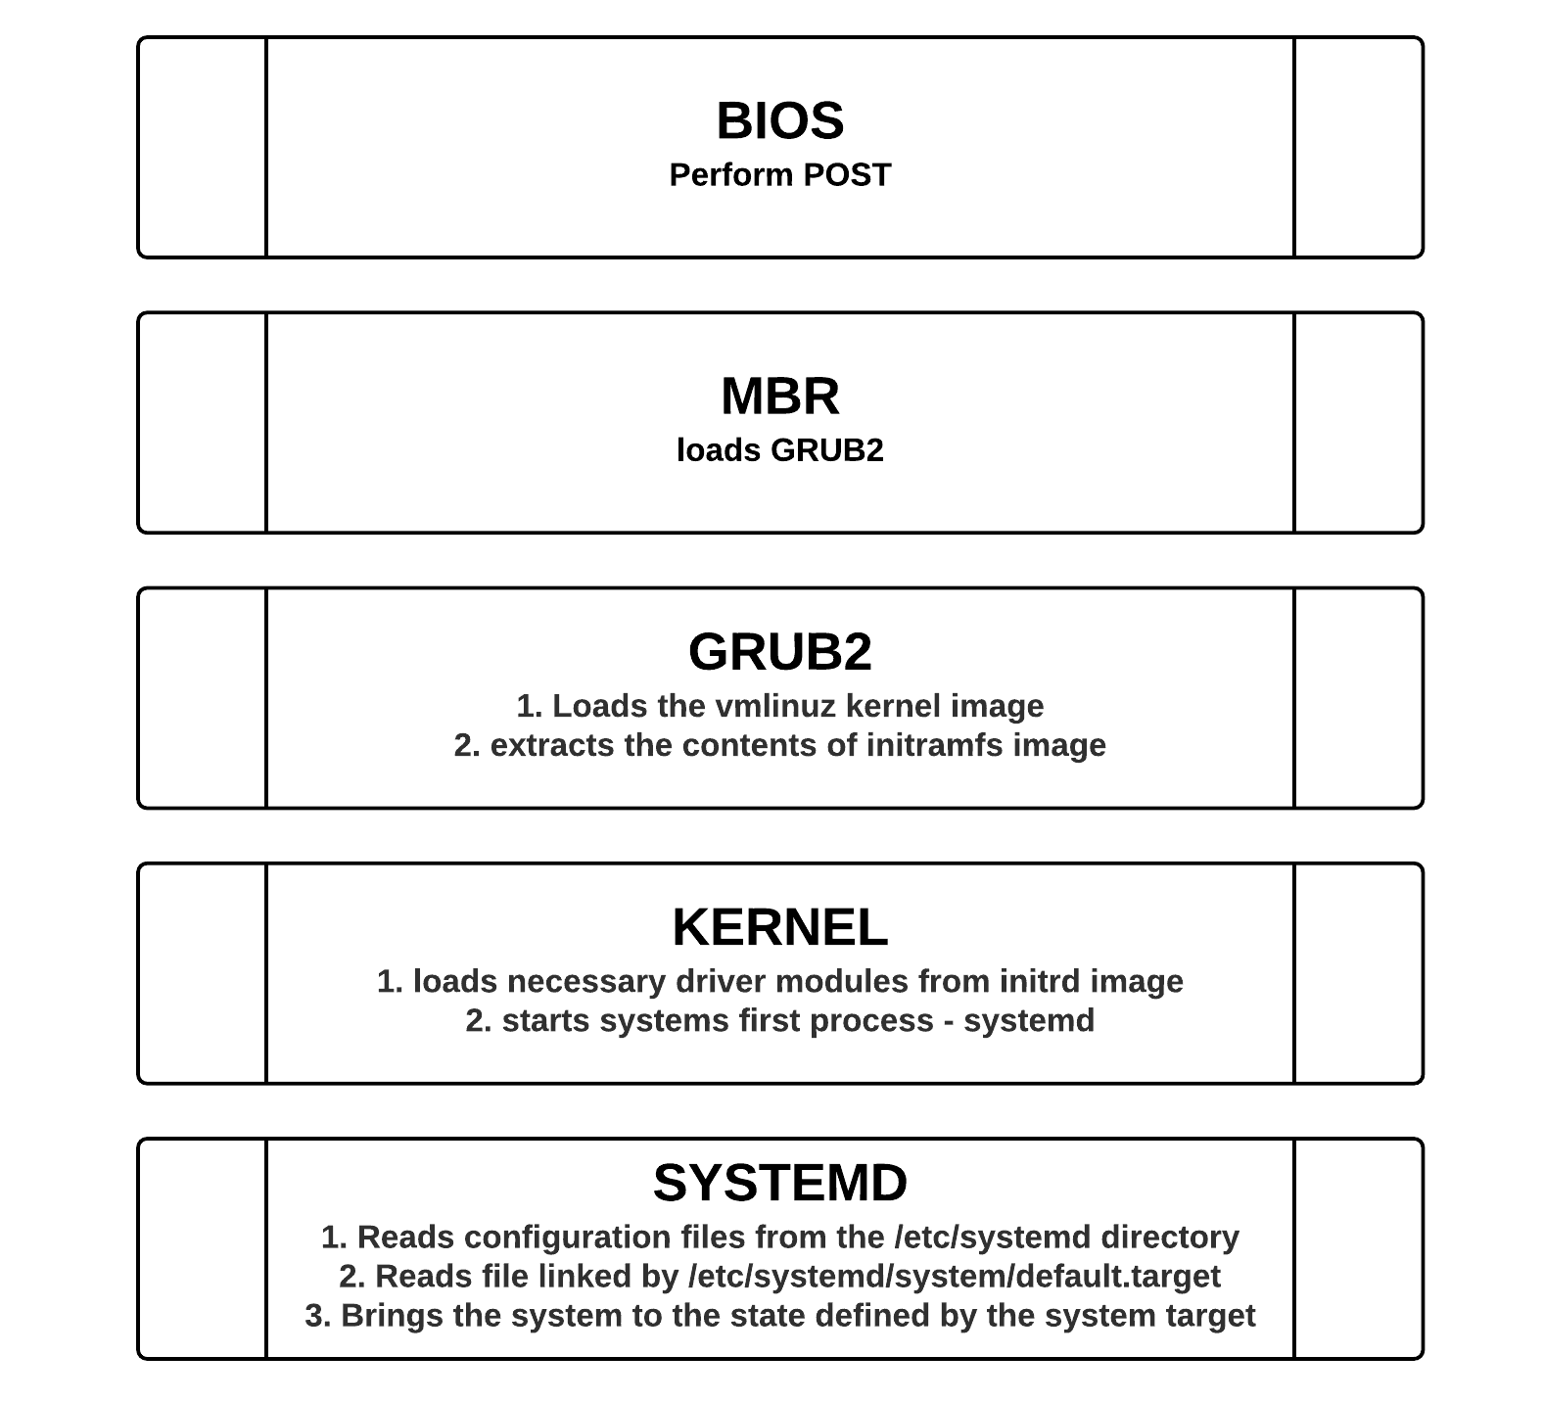
Booting process in RHEL 7

Slide 43
DAY 2

Slide 44
Booting process in RHEL 7 – Continues …
Power On --> Memtest --> CPU imaging --> Interrupt validation --> BPL --> stage 1 of boot agent (grub/lilo) --> stage 2 --> loads ramfs --> extracts kernel in memory --> invokes init/systemd
EL6 or lesser environment
Kernel --> rc.sysinit --> (upstart) /etc/inittab --> /etc/rc.d/rc?.d or /etc/rc?.d/ --> inkvoke S and K scripts --> /etc/rc.d/rc.local or /etc/rc.local --> /sbin/login
/sbin/login username
Makes a call to getent passwd username
Validates against PAM Modules if user allowed to login on station and at this time
Validates password: shadow,group,login.defs, then make a call to fork() spawn () /bin/shell_name
Switch to home dir and invoke shell initialization scripts
~/.bash_profile
~/.bashrc --> (/etc/bashrc /etc/profile) system env init)

Slide 45
Redhat Package Management & Understanding YUM repository
Redhat Package Management (RPM) is a way to install packages on a Redhat Linux system
rpm command installs "packages" from *.rpm files at any source location
Basic commands options:
rpm –i somefile.rpm (install)
rpm –U somefile (upgrade, remove old)
rpm -qa --last (query installed packages in installed sequence)
rpm -qc --last (Find out what package a config file belongs)
rpm -qcf /path/to/file (Display list of configuration files for a command)
Disadvantages
Very primitive
Have to resolve software dependencies manually
YUM on the other hand can take care of dependency resolution automatically

Slide 46
Red Hat package Management:
Syntax | Description | Example(s)
rpm -ivh {rpm-file} | Install the package | rpm -ivh mozilla-mail-1.7.5-17.i586.rpm
 |  | rpm -ivh --test mozilla-mail-1.7.5-17.i586.rpm
rpm -Uvh {rpm-file} | Upgrade package | rpm -Uvh mozilla-mail-1.7.6-12.i586.rpm
 |  | rpm -Uvh --test mozilla-mail-1.7.6-12.i586.rpm
rpm -ev {package} | Erase/remove/ an installed package | rpm -ev mozilla-mail
rpm -ev --nodeps {package} | Erase/remove/ an installed package without checking for dependencies | rpm -ev --nodeps mozilla-mail
rpm –qa | Display list all installed packages | rpm -qa
 |  | rpm -qa | less

Slide 47
Red Hat package Management:
Syntax | Description | Example(s)
rpm -qi {package} | Display installed information along with package version and short description | rpm -qi mozilla-mail
rpm -qf {/path/to/file} | Find out what package a file belongs to i.e. find what package owns the file | rpm -qf /etc/passwd
 |  | rpm -qf /bin/bash
rpm -qc {pacakge-name} | Display list of configuration file(s) for a package | rpm -qc httpd
rpm -qcf {/path/to/file} | Display list of configuration files for a command | rpm -qcf /usr/X11R6/bin/xeyes
rpm -qa --last | Display list of all recently installed RPMs | rpm -qa --last
 |  | rpm -qa --last | less
rpm -qpR {.rpm-file} | Find out what dependencies a rpm file has | rpm -qpR mediawiki-1.4rc1-4.i586.rpm
rpm -qR {package} |  | rpm -qR bash

Slide 48
Why YUM (Yellowdog Update Manager) is preferred?
Yum is the primary tool for getting, installing, updating, and deleting packages is simple.
Software Dependency Resolution - software dependencies are automatically resolved and installed.
YUM is official Red Hat/CentOS package manager, will get deprecated soon and replaced by DNF (Dandified Yum)
We normally would need a local repository to perform multiple actions, be it software installation or an update. One can simply follow below steps to create a repository of the packages that could be accessed easily and quickly
Mount RHEL DVD on /mnt (mount -t /dev/dvdwriter /mnt)
Install Publishing agent on your server, can be FTP or HTTP (rpm -ivh /mnt/Packages/vsftpd-*.rpm)
Install the Repository building tools (rpm -ivh /mnt/Packages/deltarpm-*.rpm, rpm -ivh /mnt/Packages/python-deltarpm-*.rpm, rpm -ivh /mnt/Packages/createrepo-*.rpm)
Copy all packages (rpms) to the publisher (mkdir -p /var/ftp/pub/rhel7.2 then cp -r /mnt/* /var/ftp/pub/rhel7.2)
Create the repository
createrepo -v /var/ftp/pub/rhel7/
Start and enable the publisher
systemctl enable vsftpd
systemctl start vsftpd

Slide 49
Don’t use “service --status-all” command
Please NEVER use “service --status-all " command in any of the servers to list out the status of all the services at once
Ideally for all the system defined services there will be different options associated to service command such as , status, refresh, restart , start and stop ( ex: service xyz status, service abc restart ..etc )
But in case of customized services ( application or any third party ones) there are high chances that they just configure with limited options to it
What happens when you run " service --status-all " command is, it will try to check each service configured in a server and retrieve the status of it. But if any script is configured without status option associated to it, that service(s) goes to ambiguity as there is no status option available for the service and it stop or restart whatever the functionality is configured to that service other than the status .

Slide 50
Using the created repository
YUM Repository configuration files must be located in /etc/yum.repos.d/server.repo (.repo extension, to be recognized by YUM)
# vi /etc/yum.repos.d/server.repo
[base]
name=Mphasis Local Yum Repo For Linux
baseurl=file:///var/ftp/pub/rhel7.2 → Server side configuration as it is locally available in form of files
#baseurl=ftp://192.168.167.30/pub/rhel7.2 → Client side configuration
enabled=1
gpgcheck=1
gpgkeyfile=file:///etc/REDHAT-RELEASE-Key-File-Name
Remove all temporary data file with yum clean all command
Install Telnet package from yum server
yum install telnet (-y)
After checking all dependences it will ask for conformation press y to install the package

Slide 51
Configuring network interface - Manual
First, list your network interfaces with ip command
# ip addr show
To set a Static IP address to an Interface, edit the following file with mentioned contents
/etc/sysconfig/network-scripts/ifcfg-enp0s3
DEVICE="enp0s3"
NETBOOT="yes"
HWADDR="08:00:27:15:38:B7"
TYPE="Ethernet“
BOOTPROTO="none“
ONBOOT="yes“
IPADDR="10.1.1.110"
NETMASK="255.0.0.0"
GATEWAY="10.1.1.1”
UUID="462f4834-4fe7-43a7-84e7-83b2722e94c1“
The above will set our enp0s3 network interface with static IP address 10.1.1.110. Once you have made the necessary changes restart RHEL7's system networking
# systemctl restart network
Confirm that your IP address has been updated
# ip addr show

Slide 52
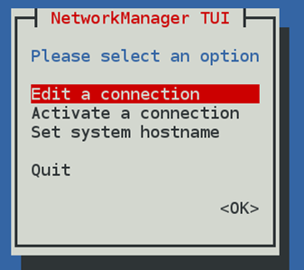
Configuring network interface - NMTUI
nmtui is actually a very easy text based tool to configure IP address and host names. Just type “nmtui” on command prompt and follow the simple steps

Slide 53
Configuring network interface - nmcli
To display a list of all connections , use
nmcli con show
To list only active connections
nmcli con show - -Active
The nmcli command can also be used to show device status and details.
nmcli dev status
The following command will add a new connection for the interface eno2, which will get IPv4 networking information using DHCP and will autoconnect on startup
nmcli con add con-name eno2 type ethernet ifname eno2
The next example configures the eno2 interface statically in stead, using the 1Pv4 address and network prefix.
nmcli con add con-name eno2 type ethernet ifname eno2 ip4 192.168.0.5/24 gw4 192.168.0.254
The nmcli con up name command will activate the connection name
nmcli con up static-eno2

Slide 54
Bridge-Interface Configuration
Validate is Bridge-Utils package is installed, if not installed, install it using
yum -y install bridge-utils
Remove the connection profile of interface that has to be a part of bridge
nmcli con show
nmcli con del profile_name
Create a new connection Profile
nmcli con add type bridge con-name br0 ifname br0
Add a slave to the Virtual Bridge
nmcli con add type bridge-slave con-name br0-port1 ifname em1 master br0
Assign IPv4 address to the bridge interface
nmcli con mod br0 ipv4.method manual ipv4.address " 192.168.10.2/24 192.168.10.1"
Set the dns Client Address
nmcli con mod br0 ipv4.dns "8.8.8.8 8.8.4.4"
Restart the Network Manager
systemctl restart NetworkManager
brctl show

Slide 55
Filesystem
A filesystem is a method and data structure that an operating system uses to keep track of files on a disk or partition; that is, the way the files are organized on the disk. The word is also used to refer to a partition or disk that is used to store the files or the type of the filesystem
Types of file systems
Disk Based File system
ext2/3/4, xfs, btrfs, ntfs, vfat
Virtual File system (Psuedo FS)
proc,sysfs,tmpfs
Netwrok File syetm
NFS,cifs,afs

Slide 56
FILE SYSTEM
Sysfs/devtmpfs is a pseudo file system provided by the Linux kernel that exports information about various kernel subsystems, hardware devices, and associated device drivers from the kernel's device model to user space through virtual files.

Slide 57
FILE SYSTEM
tmpfs is a common name for a temporary file storage facility on many Unix-like operating systems. It is intended to appear as a mounted file system, but stored in volatile memoryinstead of a persistent storage device. tmpfs is supported by the Linux kernel from version 2.4 and up. tmpfs (previously known as shmfs) is based on the ramfs code used during bootup.

Slide 58
Managing Disk Partitions
Using fdisk to create disk partitions
Building a file system with mkfs
Mounting a partition with mount
Checking the file system with fsck
Disadvantages of using native partitioning scheme
The maximum size of mount point is limited to the size of disk
Increasing/decreasing the size of a filesystem is tough
If the required filesystem size is beyond the size of one hard disk, there is no way we can achieve that
What is the solution for above disadvantages?
LVM or Logical Volume Management

Slide 59
Logical Volume Management
Logical Volume Management allows us to use storage subsystem without the limitation of confining to one disk for its usable space
For doing that, the disks should have a private region, that can store the information related to Volume Group, Logical Volume etc
Terminologies used:
Physical volume – The physical disk on which private region has been updated for storing Volume group Information
PE (Physical Extent) – Smallest unit of data block, visible on Physical volume. Total space will be rounded to the multiples of PE
Volume Group – Group of physical volumes on which Logical Volumes could be created
Logical Volume – Usable space on which filesystem can be created
LE (Logical Extent) – Smallest unit of data block, equal to PE but, visible on Logical Volume. Logical Volume size will always be rounded off to the multiples of LE

Slide 60
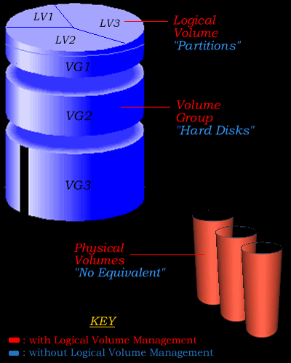
How does LVM work?
LVM hides information about where information is stored, on which hardware and where exactly on that hardware from the entire Operation system allowing it to manipulate the configuration of the storage capacity.

Slide 61
LVM - Step by Step
The first command is to prepare a disk to hold LVM information. This is done by executing pvcreate command on the physical device which turns it to something called a “physical volume”
pvcreate /dev/device [/dev/device]
Once the physical volume(s) are ready, we can group them under a Volume Group. The command vgcreate creates a volume group with all the physical volumes specified
vgcreate vg-name /dev/device [dev/device]
Finally, the command lvcreate creates a logical volume on the volume group. This is the only usable space that can be used to create filesystems
lvcreate –L size –n lv-name vg-name
Reference to the logical volume can be done in two ways
/dev/vg_name/lv_name
/dev/mapper/vg_name-lv_name (Makes use of device mapper which works efficiently with mulitipathing)

Slide 62
Extending and Reducing Logical Volume
To extend a logical volume, prerequisite is that there should be free space available in the volume group. If free space is not available, we need to add a new physical volume to the volume group, so that, the volume group gets additional free space and the same space can be made available to the logical volume.
Points to be noted
To increase the size of a mounted filesystem under LVM control, we need to take two step approach
Increase the logical volume size (lvextend)
Increase the filesystem size (resize2fs)
To decrease the filesystem size, one should be little careful as it is not a best practice. Same way, the procedure is reversed in comparison to filesystem increase
Decrease the filesystem size (resize2fs)
Reduce the logical volume size (lvreduce)
Latest LVM versions come with a tool lvresize that can perform these steps for you automatically

Slide 63
Advantages and Disadvantages of LVM
Advantages:
LVM has the capacity to manage extremely large data sets
PVs can be added, VGs and LVs can be extended while file systems are still mounted and in use (of course, reduction has to be done with unmounting of filesystem)
Maximum filesystem size is not limited to single disk space
Limitations
Extent size can only be specified once, i.e, while creating the volume group. Cannot be changed without restoring entere data if there is a requirement to do so

Slide 64
DAY 3

Slide 65
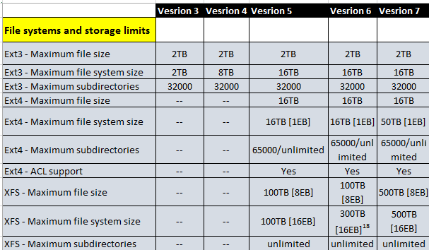
RHEL Technology limits

Slide 66
XFS Filesystem
XFS - is a high-performance 64-bit journaling file system created by SGI in 1993. It was introduced in the Linux kernel in 2001, XFS is supported by most Linux distributions, some of which use it as the default file system (RHEL/CentOS 7.0)
XFS excels in the execution of parallel input/output (I/O) operations due to its design, which is based on allocation groups, because of this, XFS enables extreme scalability of I/O threads, file system bandwidth, and size of files and of the file system itself when spanning multiple physical storage devices
XFS is file system that was designed, from day one, for computer system with large numbers of CPU and large disk arrays. It focuses on supporting large files and good streaming I/O performance.
XFS supports metadata journaling, which facilitates quicker crash recovery. The XFS file system can also be defragmented and enlarged while mounted and active. In addition, Red Hat Enterprise Linux 7 supports backup and restore utilities specific to XFS

Slide 67
XFS Features and Creating a new XFS filesystem
XFS Features:
Extended attributes (xattr)
This allows the system to associate several additional name/value pairs per file. It is enabled by default.
Quota journaling
This avoids the need for lengthy quota consistency checks after a crash.
Project/directory quotas
This allows quota restrictions over a directory tree.
Default atime behavior is relatime
Relatime is enabled by default for XFS. It has almost no overhead compared to noatime while still maintaining same atime values.
Step 1: Create a partition using fdisk
fdisk /dev/sdb --> n --> w
Step 2: Create XFS filesystem on the partition created
mkfs.xfs /dev/sdb1
Step 3: Create a mount point and mount the filesystem
mkdir /mount_point
mount /dev/sdb1 /mount_point
Step 4: Make the mount permanent by adding entry in /etc/fstab

Slide 68
XFS Filesystem actions
To repair a XFS filesystem, we can use xfs_repair
xfs_repair /dev/sdb1
The xfs_repair utility is highly scalable and is designed to repair even very large file systems with many inodes efficiently. Unlike other Linux file systems, xfs_repair does not run at boot time, even when an XFS file system was not cleanly unmounted. In the event of an unclean unmount, xfs_repair simply replays the log at mount time, ensuring a consistent file system.
The xfs_repair utility cannot repair an XFS file system with a dirty log. To clear the log, mount and unmount the XFS file system. If the log is corrupt and cannot be replayed, use the -L option ("force log zeroing") to clear the log, that is, xfs_repair -L /dev/device. Be aware that this may result in further corruption or data loss.
The -D option can help us to increase the XFS filesystem's size. Unfortunately, XFS does not allow to shrink once created
xfs_growfs /mount_point –D size
Write activities could be suspended on XFS. To suspend or resume write activity to a file system, use xfs_freeze. Suspending write activity allows hardware-based device snapshots to be used to capture the file system in a consistent state.
The xfs_freeze utility is provided by the xfsprogs package, which is only available on x86_64.
The xfs_freeze utility can also be used to freeze or unfreeze an ext3, ext4, GFS2, XFS, and BTRFS, file system

Slide 69
BtrFS (B-Tree FileSystem)
What is BtrFS
It is the Next Generation Linux File System for Linux
BtrFS is a new copy on write filesystem for Linux aimed at implementing advanced features while focusing on fault tolerance, repair, and easy administration.
BtrFS uses a b-tree derivative optimized for copy-on-write and concurrency created by IBM researcher Ohad Rodeh for every layer of the file system
Definitions
Copy-on-write (COW): data is copied when it is written to add redundancy; also called shadowing
Inode: data structure used to store basic information about a file system component
Extent: a contiguous block of allocated storage
Checksum: a hash value used to check the integrity of stored data
Snapshot: a copy of the file system taken at a certain point in time; also called a clone

Slide 70
BtrFS design targets (as on 2007)
Storage pools
Writeable, named, recursive snapshots
Fast filesystem checking and recovery
Easy large storage management for admins
Proactive error management
Better security
High scalability − 128 CPU cores, 256 spindles, hundreds of subvolumes
Fast incremental backup
Little history on BtrFS
Christ Mason started looking into a new FS in 2007 after attending to LSF workshop
Got inspired by IBM research report about COW-based snapshots
Had vast experience and lesson learned from other Linux filesystems (reiserfs etc)
Received lots of support from community and multiple companies to work further on BtrFS

Slide 71
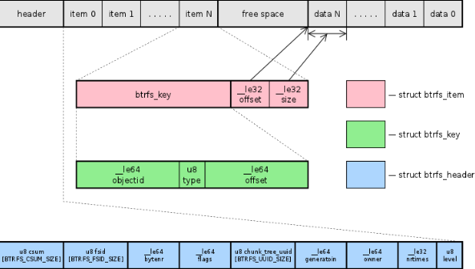
BtrFS basics – B-Tree & Leaf Nodes
Everything is in a B-Tree
Three basic on-disk data structures
Block header
Keys
Items
Every tree block is node or leaf
All starts with block header and keys
Only leaves store the actual data
Copy on write protect tree integrity

Slide 72
BtrFS – B-Tree and Advangates
Has one main btree plus 6 special purpose btree
fs tree (main tree)
extent allocation tree
chunk tree
device allocation tree
checksum tree
data relocation tree
log root tree
Share single btree implementation code
Metadata from different files and directories is mixed together in a block
Advantages
No journaling block layer
No modification in place
Tree is cloned
New roots are added into root tree
Will not commit and link the new root until all data and metadata are written to disk
Original trees/nodes can be differenced

Slide 73
Systemd
System is the first process in RHEL7
Systemd is modular
Asynchronous and concurrent
Described by declarative sets of properties
Bundled with analysis tools and tests
Features a fully language-agnostic API
One daemon (service) to rule them all!
xinetd: a daemon to lazily launch internet services when activity is detected on an AF_INET socket
systemd: a daemon to lazily launch any system service when activity is detected on an AF_UNIX socket (oversimplification)
To know which daemons started by systemd directly?
Try: 'ls /lib/systemd/system/*.service'
Try: 'systemctl list-sockets'

Slide 74
Systemd features
Speeds up booting by loading services concurrently
Allows you to manage various types of units on a system, for example:
services (name.service)
targets (name.target)
devices (name.device)
file system mount points (name.mount)
sockets (name.socket)
Snapshotting of the system state and restoration of the system state from a snapshot is supported
Mount points can be configured as systemd targets

Slide 75
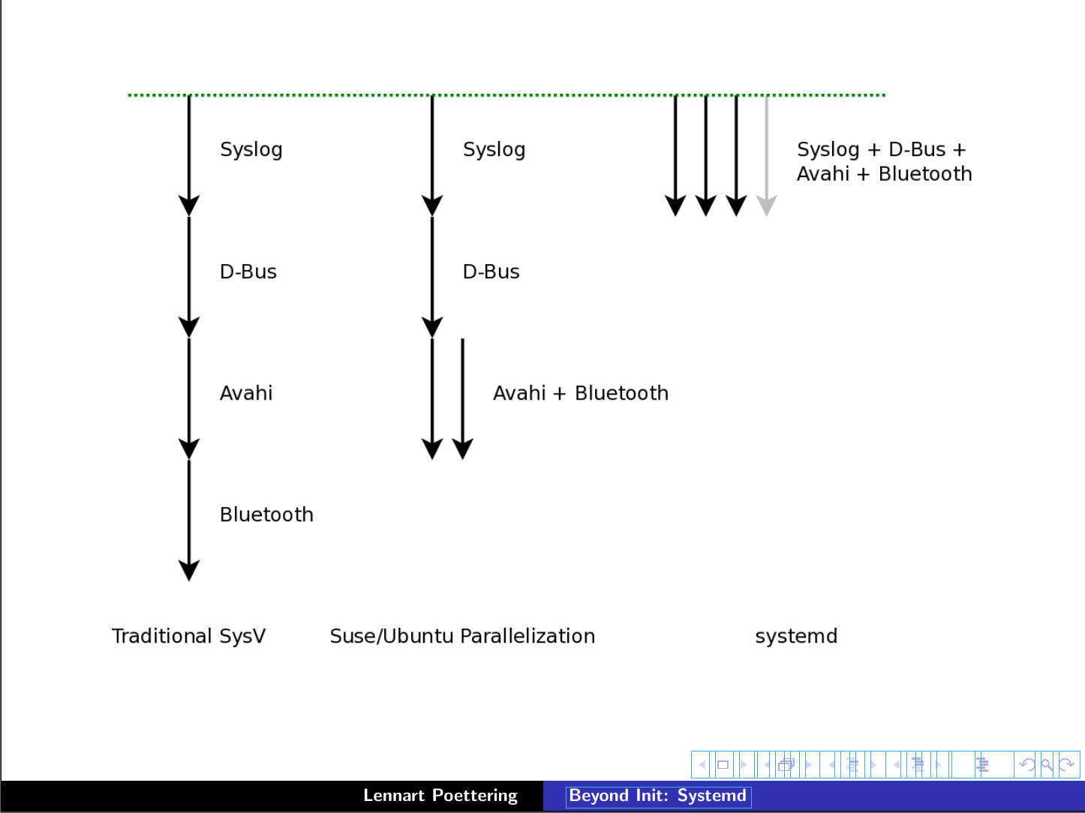
Systemd – How it works
Serial
Linked list
Fully parallel
X
Upstart

Slide 76
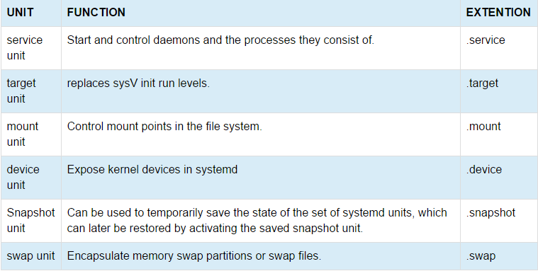
Systemd – Unit Types

Slide 77
Systemd – Configuration files
Systemd units are defined by unit configuration files located in the following directories
/usr/lib/systemd/system
Systemd units created at runtime. This directory takes precedence over the directory with installed service units
/etc/systemd/system
Systemd units created and managed by the system administrator. This directory takes precedence over the directory with runtime units

Slide 78
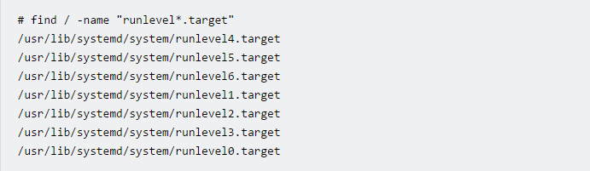
Systemd – Target Units
OS versions prior to RHEL7 were using SysV init run levels to allow a system to be used for a specific purpose
In RHEL 7, run levels have been replaced with systemd target units
Target units have a .target extension
Target units allow you to start a system with only the services that are required for a specific purpose
To list the predefined systemd run level target units

Slide 79
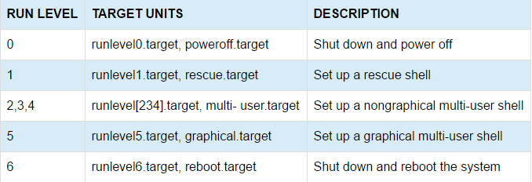
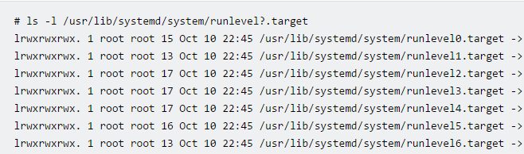
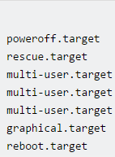
Systemd – Run Level vs Target Units
The table below shows the system-state targets which are equivalents of run-levels
Each runlevel[0123456].target file is a symbolic link to the system-start target equivalent. For e.g. :

Slide 80


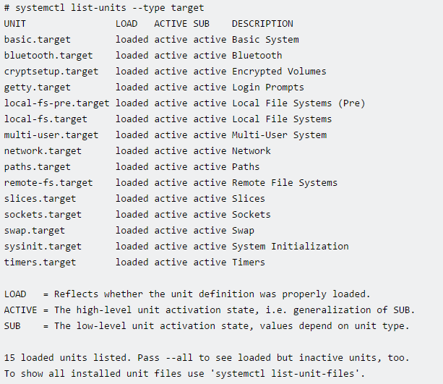
Systemd – Viewing available targets
To view which target unit is used by default use :
multi-user target is equivalent of run level 3. This can be verified using runlevel command
To list currently active targets on the system use :

Slide 81

Systemd – Changing Targets
Use the systemctl set-default command to change the default target unit to the graphical.target unit.
Notice that the default.target symbolic link has changed, and is now pointing to the graphical.target unit
The change of default target does not change the currently active target. To change currently active target:

Slide 82
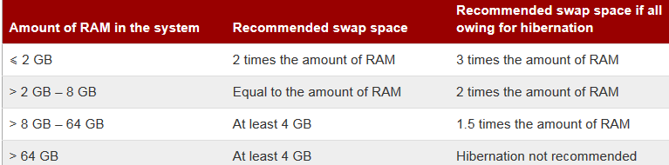
Swap Management
Swap space in Linux is used when the amount of physical memory (RAM) is full. If the system needs more memory resources and the RAM is full, inactive pages in memory are moved to the swap space. While swap space can help machines with a small amount of RAM, it should not be considered a replacement for more RAM
Common Swap recommendations depending on available Physical Memory (RAM)

Slide 83
Adding Swap space – Swap File
We have three options:
Create a new swap file (Not recommended, but, can be handy if swap is running out)
Create a new swap partition (Need to have free disk space to create additional partition, use fdisk to create partition)
Extend swap on an existing LVM2 logical volume (Free space in Volume Group should be present)
Creating Swap File: Determine the size of the new swap file in megabytes and multiply by 1024 to determine the number of blocks. For example, the block size of a 64 MB swap file is 65536.
Type the following command with count being equal to the desired block size.
Setup the swap file with t dd if=/dev/zero of=/swapfile bs=1024 count=65536
he command
mkswap /swapfile
It is recommended that the permissions are changed to prevent the swap being world readable.
chmod 600 /swapfile
To enable the swap file immediately but not automatically at boot time
swapon /swapfile
To enable it at boot time, edit /etc/fstab to include the following entry
/swapfile swap swap defaults 0 0
It can be checked using swapon -s or cat /proc/swaps

Slide 84
Adding Swap space – LVM
Create the LVM2 logical volume of size 2 GB
lvcreate VolGroup00 -n LogVol02 -L 2G
Format the new swap space
mkswap /dev/VolGroup00/LogVol02
Add the following entry to the /etc/fstab file
/dev/VolGroup00/LogVol02 swap swap defaults 0 0
Enable the extended logical volume
swapon -v /dev/VolGroup00/LogVol02
To extend a Swap on existing Logical Volume
Disable swapping for the associated logical volume
swapoff -v /dev/VolGroup00/LogVol01
Resize the LVM2 logical volume by 2 GB (Any size)
lvresize /dev/VolGroup00/LogVol01 -L +2G
Format the new swap space:
mkswap /dev/VolGroup00/LogVol01
Enable the extended logical volume:
swapon -v /dev/VolGroup00/LogVol01

Slide 85
DAY 4

Slide 86
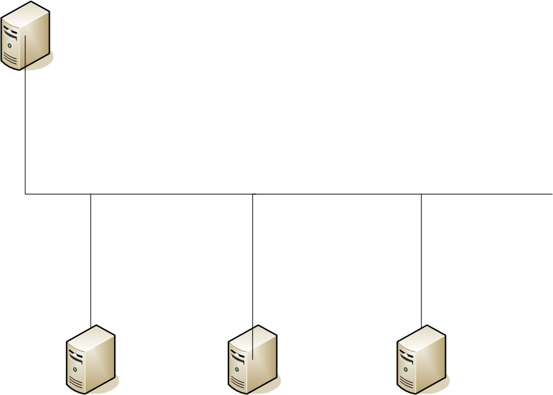
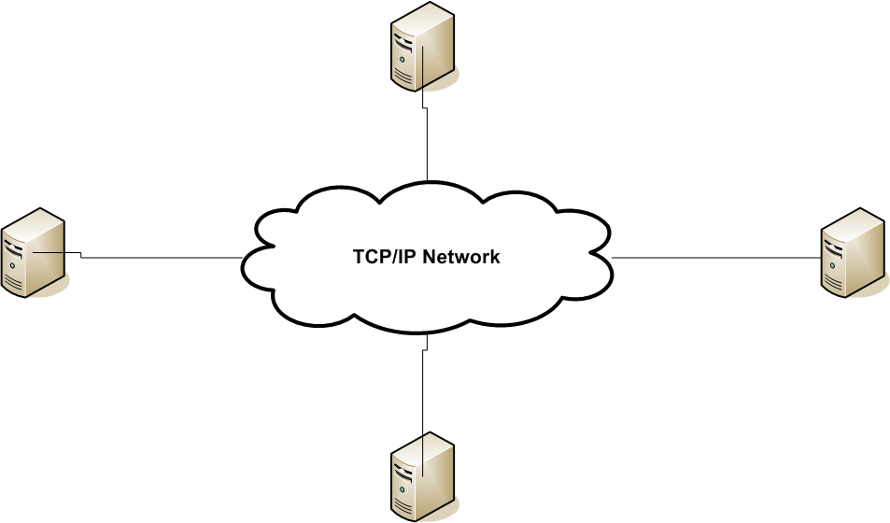
Introduction to iSCSI
iSCSI is a low cost Storage Area Network (SAN) protocol that allows for SCSI command transmission over a TCP/IP network
iSCSI allows for the sharing of I/O devices over a long distance, especially storage devices
Typically high speed disk arrays
iSCSI maintains the SCSI notion of an Initiator and Target device
iSCSI removes the traditional bus structure of SCSI and maps SCSI over a network
Bus Architecture
Network Architecture

Slide 87
iSCSI Terminologies
iSCSI Target - The server that shares Disk/LUN over TCP/IP
iSCSI Initiator – The Client which sends the SCSI commands to the Target over TCP/IP
iSCSI Session Types
iSCSI has two Session types
Discovery
Normal
Each Session has two (2) Phases
Login
Contains Security Negotiation and Operational Parameter Negotiation
Full Feature Phase

Slide 88
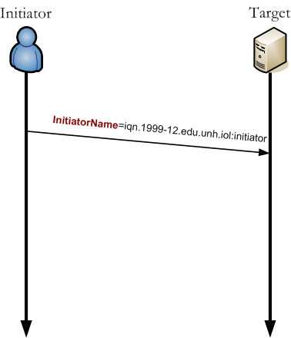
iSCSI Sessions and Phases in detail – Discovery Session
Discovery Session
A Discovery Session is used to allow the iSCSI Initiator to find iSCSI Targets that it can connect to the Initiator must explicitly tell the Target that the Session to be created be a Discovery Session
SessionType=Discovery
Login within Discovery
Allows the Initiator and Target to establish 'who' it is
Full Feature Phase within Discovery
Once the Login Phase has completed, the Session can transfer into Full Feature Phase (FFP)
Within a Discovery Session, FFP allows the sending of Text Requests (Initiator) and Text Responses (Target)
Used to let the Target inform the Initiator what devices it can access
No other types of data units may be transmitted

Slide 89
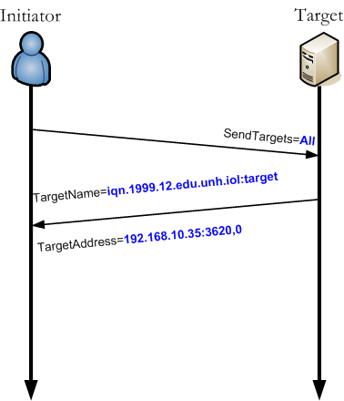
iSCSI Sessions and Phases in detail – Discovery Session Continued…
Discovery Session
Initiator transmits the SendTargets key to the Target
Target replies with a list of devices accessible to the Initiator and their addresses
Once a Discovery Session has completed, the Session must be terminated
If the Initiator then desires to perform data I/O, a Normal Session must be created

Slide 90
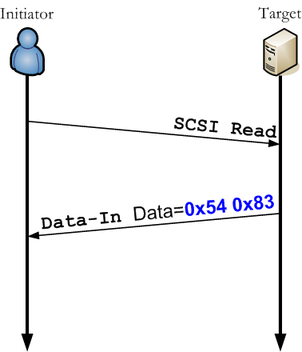
iSCSI Sessions and Phases in detail – Normal Session
Normal Session
An iSCSI Initiator will explicitly tell the iSCSI Target that the Session to be created is a Normal Session
A Normal Session is defined in RFC 3720 to be an unrestricted session
Access to SCSI devices can only be achieved while in a Normal Session
Login within Normal Session
Allows the Initiator and Target to declare/negotiate data transmission rules and other connection settings
Ex. Size of individual data units, number of simultaneous data transfers
Full Feature Phase in Normal Session
Once Full Feature Phase (FFP) within a Normal Session has been reached, data I/O can take place

Slide 91
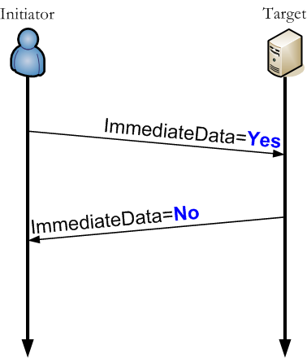
iSCSI Key Negotiation Overview
Key Negotiation Overview
All iSCSI parameters are contained within key=value pairs
Ex. “TargetAlias=UNH-IOL”
Some keys are declared and others are negotiated
Declared keys do not need a response from the receiver
Negotiated keys must always receive a response from the receiver
iSCSI Key Negotiation
Key negotiations can allow the enabling or disabling of features
Also allows for value negotiation or declaration
Ex. MaxBurstLength=512

Slide 92
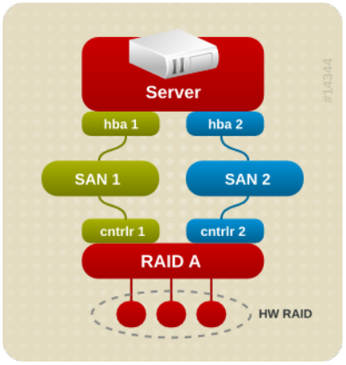
Device Mapper Multipath (DM Multipath) in RHEL7
Device mapper multipathing (DM Multipath) allows you to configure multiple I/O paths between server nodes and storage arrays into a single device. These I/O paths are physical SAN connections that can include separate cables, switches, and controllers. Multipathing aggregates the I/O paths, creating a new device that consists of the aggregated paths
DM Multipath can be used to provide:
Redundancy
DM Multipath can provide failover in an active/passive configuration. In an active/passive configuration, only half the paths are used at any time for I/O. If any element of an I/O path (the cable, switch, or controller) fails, DM Multipath switches to an alternate path.
Improved Performance
DM Multipath can be configured in active/active mode, where I/O is spread over the paths in a round-robin fashion. In some configurations, DM Multipath can detect loading on the I/O paths and dynamically rebalance the load
Can protect from
HBA failure
FC cable failure
SAN switch failure
Array controller port failure

Slide 93
DM Multipath Overview
DM Multipath includes compiled-in default settings that are suitable for common multipath configurations. The basic procedure for configuring your system with DM Multipath is as follows:
Install the device-mapper-multipath rpm
Create the configuration file and enable multipathing with the mpathconf command. You can also start the multipath daemon with this command if you do not need to edit the configuration file
If necessary, edit the multipath.conf configuration file to modify default values and save the updated file
Start the multipath daemon

Slide 94
Multipath Device Identifiers
Each multipath device has a World Wide Identifier (WWID), which is guaranteed to be globally unique and unchanging. By default, the name of a multipath device is set to its WWID.
Alternately, you can set the user_friendly_names option in the multipath configuration file, which sets the alias to a node-unique name of the form mpathN.
For example, a node with two HBAs attached to a storage controller with two ports by means of a single unzoned FC switch sees four devices: /dev/sda, /dev/sdb, dev/sdc, and /dev/sdd. DM Multipath creates a single device with a unique WWID that reroutes I/O to those four underlying devices according to the multipath configuration.
When the user_friendly_names configuration option is set to yes, the name of the multipath device is set to mpathN.
When new devices are brought under the control of DM Multipath, the new devices may be seen in two different places under the /dev directory: /dev/mapper/mpathN and /dev/dm-N
The devices in /dev/mapper are created early in the boot process. Use these devices to access the multipathed devices, for example when creating logical volumes.
Any devices of the form /dev/dm-n are for internal use only should never be used by the administrator directly.

Slide 95
iSCSI Initiator and Multipath commands
Prerequisite: Setup OpenFiler with two interfaces 192.168.56.100 and 192.168.57.100 with three LUNs published over iSCSI target without Authentication. On the server side, add two Host Only network cards having 192.168.56.50 and 192.168.57.50 IP addresses.
On the iSCSI client side, ensure iscsi-initiator-utils* rpm(s) are installed
yum install iscsi-initiator-utils*
Make sure the IQN is updated in the initiatorname.iscsi file
cat /etc/iscsi/initiatorname.iscsi
Discovery, login and access the iSCSI targets
iscsiadm -m discovery -t sendtargets -p 192.168.56.100
iscsiadm -m node -o show
iscsiadm -m node --login
iscsiadm -m session -o show
lsscsi
For multipath demonstration, ensure that device-mapper-multipath* rpm(s) are installed
yum install device-mapper-multipath*
Copy the default multipath.conf file and start the daemon
cp /usr/share/doc/device-mapper-multipath-0.4.9/multipath.conf /etc/multipath.conf
systemctl start multipathd
systemctl enable multipathd
Verify the multipathing configuration. Confirm by disabling one network to see access to multipath device is intact
multipath -ll -v2

Slide 96
iSCSI Target assignment and Initiator commands
On the iSCSI Target server, install targetcli and get into targetcli by executing the command
/>cd /backstores/block
/backstores/block> create iscsi_store /dev/vg2/iscsi_lv → Create an iSCSI Store
/backstores/block> cd /iscsi
/iscsi> create iqn.2017-05.local.centos7.example.com:disk1 → Create Target iQN
/iscsi> cd /iscsi/iqn.2017-05.local.centos7.example.com:disk1/tpg1/acls
/iscsi/iqn.20...sk1/tpg1/acls>create iqn.2017-05.local.centos7.example.com:node1 → Create ACL
/iscsi/iqn.20...sk1/tpg1/acls>cd ..
/iscsi/iqn.20...om:disk1/tpg1> set attribute authentication=0 → Disable Authentication
/iscsi/iqn.20...om:disk1/tpg1> set attribute generate_node_acls=1
/iscsi/iqn.20...om:disk1/tpg1> cd luns
/iscsi/iqn.20...sk1/tpg1/luns> create /backstores/block/iscsi_store → Map created Store to the LUN
/iscsi/iqn.20...sk1/tpg1/luns> cd /
/> ls → Confirm all the configuration are at acceptable level
o- / ............................................................................ [...]
o- backstores ................................................................. [...]
| o- block ..................................................... [Storage Objects: 1]
| | o- iscsi_store ................ [/dev/vg2/iscsi_lv (3.0GiB) write-thru activated]
| o- fileio .................................................... [Storage Objects: 0]
| o- pscsi ..................................................... [Storage Objects: 0]
| o- ramdisk ................................................... [Storage Objects: 0]
o- iscsi ............................................................... [Targets: 1]
| o- iqn.2017-05.local.centos7.example.com:disk1 .......................... [TPGs: 1]
| o- tpg1 ..................................................... [gen-acls, no-auth]
| o- acls ............................................................. [ACLs: 1]
| | o- iqn.2017-05.local.centos7.example.com:node1 ............. [Mapped LUNs: 1]
| | o- mapped_lun0 .............................. [lun0 block/iscsi_store (rw)]
| o- luns ............................................................. [LUNs: 1]
| | o- lun0 ............................. [block/iscsi_store (/dev/vg2/iscsi_lv)]
| o- portals ....................................................... [Portals: 1]
| o- 0.0.0.0:3260 ........................................................ [OK]
o- loopback ............................................................ [Targets: 0]
/> saveconfig → Save configuration
/> exit
systemctl enable target.service
systemctl start target.service
Initiator commands remain same as in previous exercise, with only server IP differing

Slide 97
Introduction to Red Hat Cluster Suite
One of the oldest problems of computing is designing failure proof computing systems. Over the years, many different methods have been developed. Many of these you will be familiar with, including:
Spare hardware – typically enough to mirror the production hardware.
Fault tolerant hardware by using a number of spare components.
Software failover features built into individual programs.
Hardware solutions are typically expensive (and not always 100% reliant). Application ­specific failover methods can often add maintenance hassles as well as doing nothing to fix the problem that
some of your programs may have no failover capabilities at all
Clustering is an answer for this. There are three main reasons to use clustering:
Better performance
Fault tolerance by high availability services.
Optimal usage of disk resources.
Red Hat Cluster Suite (RHCS) is an integrated set of software components that can be deployed in a variety of configurations to suit your needs for performance, high-availability, load balancing, scalability, file sharing, and economy

Slide 98
Basics of Clustering
RHCS consists of the following major components
Cluster infrastructure — Provides fundamental functions for nodes to work together as a cluster: configuration-file management, membership management, lock management, and fencing
High-availability Service Management — Provides failover of services from one cluster node to another in case a node becomes inoperative
Cluster administration tools — Configuration and management tools for setting up, configuring, and managing a Red Hat cluster. The tools are for use with the Cluster Infrastructure components, the High-availability and Service Management components, and storage
Linux Virtual Server (LVS) — Routing software that provides IP-Load-balancing. LVS runs in a pair of redundant servers that distributes client requests evenly to real servers that are behind the LVS servers
GFS — GFS (Global File System) or GFS2 (Global File System 2) provides a cluster file system for use with Red Hat Cluster Suite. GFS/GFS2 allows multiple nodes to share storage at a block level as if the storage were connected locally to each cluster node
Cluster Logical Volume Manager (CLVM) — Provides volume management of cluster storage

Slide 99
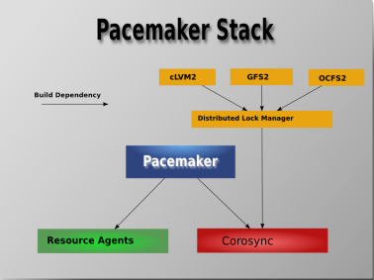
RHCS Architecture
Pacemaker – Resource Manager
Corosync – Maintains Cluster Membership. Messaging and Membership Service
RA(Resource Agents) – Handle the resources
STONITH – Fencing (Shoot The Other Node In The Head)
Resources – Individual Services
Resource Group – Group of resources that publish a service
Constraint – Dependencies between resources
cLVM – Cluster Logical Volume Manager
GFS2 – Global File System v2
OCFS2 – Open Clustered File System v2

Slide 100
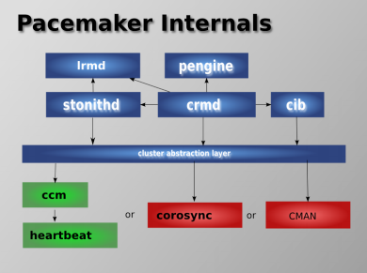
Pacemaker components
Pacemaker itself is composed of five key components:
Cluster Information Base (CIB)
Cluster Resource Management daemon (CRMd)
Local Resource Management daemon (LRMd)
Policy Engine (PEngine or PE)
Fencing daemon (STONITHd)
Designated Controller

Slide 101
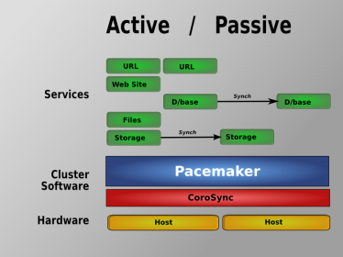
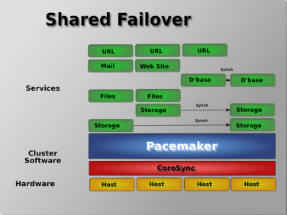
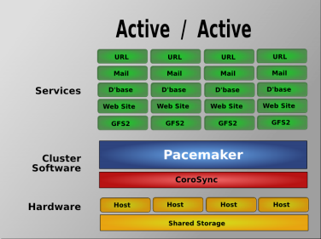
Types of Pacemaker Clusters
Active-Passive
One Node will be active at a time
Other node always wait for forst node to go down
Costly as one node lies unused most of the time
Shared-Failover
This is the common type of setup
Hybrid in nature
Multiple hosts serve as passive nodes for a service running on other node
Can be setup when multiple hosts are forming cluster
Active-Active
All the nodes host part of the service on them
Most efficient, but, not all application can be setup to be Active-Active in nature

Slide 102
Configuring Apache on RHEL 7
Step 1: Install httpd from Yum repository
Step 2: Copy sample httpd.conf file to /etc/httpd/conf directory
Step 3: Update Document Root, Virtual Directory and permissions, Specify Default Document (index.html)
Step 4: Enable httpd and start httpd
Step 5: Allow access through firewalld if firewalld is enabled

Slide 103
Tip: Recover lost root password in RHEL7
Step 1: reboot the server
Step 2: on grub prompt select edit for the kernel
Step 3: locate line with /vmlinuz entry on this line replace rhgb quite with init=/bin/bash
Step 4: Press Ctrl+x to boot
Step 5: when on # prompt, execute “mount -o remount,rw /”
Step 6: passwd root (change the password)
Step 7: touch /.autorelabel

Slide 104

Questions ☺

